Slide 1
Structure and Function of DNA
December 25, 2016

Slide 2
The chemical structure of DNA
DNA can be thought of as a string of 4 different letters: A, T, C, and G.

Slide 3
Proof that DNA is the molecule that carries genetic information
Nonpathogenic R bacteria are transformed to pathogenic S bacteria by the DNA from heat-killed S cells.

Slide 4
A-T and C-G complementary base pairs have the same geometry

Slide 5
3-D structure of DNA
DNA folds into a double-stranded helix.

Slide 6
DNA structure provides a mechanism for replication

Slide 7
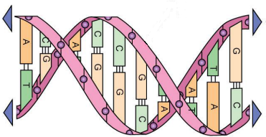
DNA is the “Instruction Manual” for every species
ENGLISH LANGUAGE | DNA
Alphabet - 26 letters A, B, C, … Z | Alphabet - 4 nucleotides A, T, C, G
War and Peace ~3.2 million letters 17 volumes 365 chapters | Human genome ~3.2 billion nucleotides 23 chromosomes ~22,000 genes
 | Corn genome ~2 billion nucleotides 10 chromosomes ~32,000 genes
 | E. Coli genome ~4.6 million nucleotides 1 chromosome ~4,400 genes
The Double Helix
Corn

Slide 8
Differences in DNA sequence have important applications
Identity testing
Paternity testing
Forensics
Pre-marital screening
Dor Yeshorim
Personalized medicine
Cancer diagnosis and treatment

Slide 9
Summary
The DNA alphabet has four letters: A, T, C, and G.
The 3-D structure of DNA is a double-stranded helix.
Complementary base pairing between opposite strands (A-T and C-G) is the basis for the replication of DNA when cells divide.
The information contained in the sequence of bases (letters) within the DNA of every species is the “instruction manual” for its creation and all of its functions.

Slide 10
Summary, continued…
The human genome is divided into 23 chromosomes (volumes) each containing a very long DNA molecule averaging about 140 million bases. The total length of the human genome is approximately 3.2 billion bases.
The determination of a person’s DNA sequence will become a routine medical test essential for patient care.
Differences in DNA sequence between individuals have important applications in identity testing, pre-marital screening, and personalized medicine.
Determination of the alterations (mutations) in the DNA sequence of cancer cells will revolutionize the diagnosis and treatment of cancer.

